Slide 1
HEA 1423 Anti-Bullying Law Community Meeting
Scott Backus
TVMS Assistant Principal
TVSC School Safety Specialist
Community Member and Father of kids at TVSC

Slide 2
By the numbers…
According to the Centers for Disease Control’s 2011 Youth Risk Behavior Survey:
Indiana ranks 3rd in the nation for incidences of electronic bullying and bullying on school property
1 in 4 students had been bullied at school during the past 12 months prior to the survey
1 in 5 students had been bullied electronically during the past 12 months prior to the survey
1 in 20 youth did not go to school in the past 30 days prior to the survey for fear of safety at school or going to and from school
Long Term Impact: Studies from the National School Safety Center reported that 60 percent of students who were identified as school bullies ended up with a criminal record by age 24.

Slide 3
The Voiceless…
Students reach out to an adult in only about 1/3 of the cases of bullying…why is that?
Students do not perceive that teachers or adults in the school will do anything.
Don’t want to be perceived as weak or a “tattletale”
Fear of retaliation from bully
Feelings of humiliation make children ashamed to tell adults
May already feel socially isolated and believe no one cares or can understand
Fear of rejection by peers
Parent reaction

Slide 4
HEA 1423 Timeline
Enacted July 1, 2013.
TVSC School Safety Specialists, Scott Backus and Jon Hutton, attend IDOE information seminar on HEA 1423 – September 5th
The ISBA policy language was accepted October 1, 2013
TVSC Policy initial reading October board meeting
TVSC policy approved by the board in November
Anti-Bullying programs take place with students in all TVSC schools before October 15th (LAW)
Staff meetings on the new law took place for teachers in October
Meetings are in the works for bus drivers and other support staff
Community meetings - November

Slide 5
Bullying…The LEGAL Definition
IC 20-33-8-0.2 – “Bullying” means:
Overt (intentional) unwanted, repeated acts or gestures including:
Verbal or Written communication, or images transmitted in any manner (including digitally or electronically)
Physical acts committed, aggression, or any other behaviors that are committed by a student or group of students against another student with the intent to
Harass, ridicule, humiliate, intimidate, or harm the targeted student and
Create for the targeted student an objectively hostile school environment

Slide 6
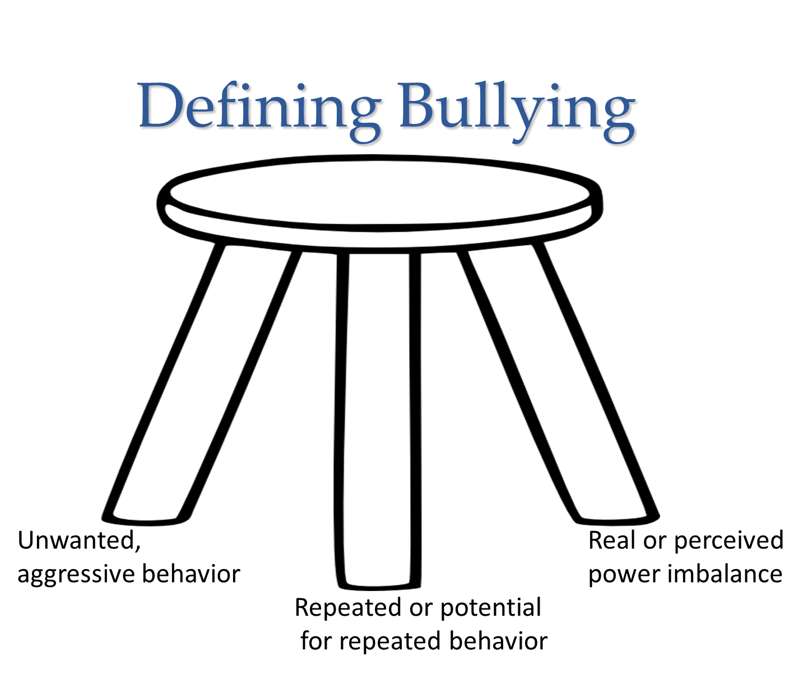

Slide 7
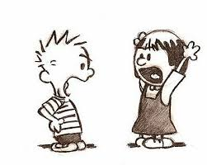
What is NOT bullying?
There are many other types of aggressive behavior that don’t fit the definition of bullying. This does not mean that they are any less serious or do not require intervention.
Peer Conflict →
Harassment
(What we see most)
Teen Dating Violence
Hazing
Gang Violence
Stalking

Slide 8
Conflict or Bullying?

Slide 9
Bullying TARGET Risk Factors…
Perceived as “being different” from peers
Perceived sexual orientation
Perceived ability/disability level
Perceived socioeconomic status
Poor social skills
Socially isolated/few friends
Overweight/underweight
Many more….basic premise of “perceived difference”

Slide 10
Why do students bully others?
Information about bullying suggests that there are three interrelated reasons why students bully.
Students who bully have strong needs for power and (negative) dominance.
Students who bully find satisfaction in causing injury and suffering to other students.
Students who bully are often rewarded in some way for their behavior with material or psychological rewards.

Slide 11
Effects on Targets
Kids who are bullied can experience negative physical, school, and mental health issues. Kids who are bullied are more likely to experience:
Depression and anxiety, increased feelings of sadness and loneliness, changes in sleep and eating patterns, and loss of interest in activities they used to enjoy. These issues may persist into adulthood.
Health complaints
Decreased academic achievement—GPA and standardized test scores—and school participation. They are more likely to miss, skip, or drop out of school.
A very small number of bullied children might retaliate through extremely violent measures. In 12 of 15 school shooting cases in the 1990s, the shooters had a history of being bullied.

Slide 12
Tippecanoe Valley School Corporation Anti-Bullying Policy

Slide 13
TVSC Bullying/Cyberbullying Policy: Indiana Code 20-33-8-0.2
1. Bullying committed by students toward other students is strictly prohibited. Engaging in bullying conduct described in this rule by use of data or computer software that is accessed through any computer, any computer system, or any computer network is also prohibited.
2. For purposes of this rule, bullying is defined as overt, unwanted, repeated acts or gestures, including verbal or written communications or images transmitted in any manner including electronically or digitally, physical acts committed, aggression, or any other similar behaviors that are committed by a student or group of students against another student with the intent to harass, ridicule, humiliate, intimidate, or harm the targeted student and create for the targeted student an objectively hostile school environment that:
- places the targeted student in reasonable fear of harm to the targeted
student’s person or property;
- has a substantially detrimental effect on the targeted student’s physical or
mental health;
- has the effect of substantially interfering with the targeted student’s
academic performance; or
- has the effect of substantially interfering with the targeted student’s ability
to participate in or benefit from the services, activities, and privileges
provided by the school.
3. This rule may be applied regardless of the physical location of the bullying behavior when a student committing bullying behavior and the targeted student attend a school within the school corporation and disciplinary action is reasonably necessary to avoid substantial interference with school discipline or prevent an unreasonable threat to the rights of other students to a safe and peaceful learning environment.
4. Any student or parent who has knowledge of conduct in violation of this rule or any student who feels he/she has been bullied in violation of this rule should immediately report the conduct to the building principal/assistant principal who has responsibility for all investigations of student misconduct including bullying. A student or parent may also report the conduct to a teacher or counselor who will be responsible for notifying the principal/assistant principal. This report may be made anonymously.
5. False reporting of bullying conduct as defined in this rule by a student shall be considered a violation of this rule and will result in any appropriate disciplinary action or sanctions if the investigation of the report finds it to be false.
6. A violation of this rule prohibiting bullying may result in any appropriate disciplinary action or sanction, including suspension and/or expulsion.
7. Counseling, corrective discipline, and/or referral to law enforcement will be used to change the behavior of the perpetrator. This includes appropriate intervention(s), restoration of a positive climate, and support for victims and others impacted by the bullying.
LEGAL REFERENCE: I.C. 20-33-8-0.2 and I.C. 20-33-8-13.5

Slide 14
Keys to the policy…
#3 – Rule applied regardless of physical location
#4 – Report it!
The school is the 24/7 police of the new law
ANYWHERE and ANYTIME
Requirement: Two students from the same corporation
Cyberspace
Text
Social Media
False profiles
Snapchat
Gone in 10 seconds!
“Sexting” → Sending inappropriate pictures
Angry parent - “I’m so sick of this school doing nothing about my kid getting bullied!”
Me – “To whom have you reported this problem?”
Angry parent – “I didn’t call anyone because I thought my son could handle it.”
We cannot deal with what we don’t know about!
Online Student/Parent Report Forms
CALL/E-mail/Stop in

Slide 15
Addressing Bullying…
A report is filed and/or an issue is turned over to the office. The new law has a required reporting component for staff.
An investigation will be conducted by the school administrator.
The administrator will determine if we have a bullying case or another type of conflict.
ALL reported cases are and will continue to be addressed regardless of bullying or conflict.
If bullying:
Disciplinary action will take place. This can range from a first time warning to suspension depending on severity. “ZERO TOLERANCE” is not a component of the law or the TVSC policy.
Parents will be contacted for both the target and bullier. By LAW, we cannot disclose the disciplinary action taken against another student, nor can we show parents video with other students in it.
Appropriate intervention will be determined for the target and bullier. This can range from counseling to intensive behavioral health programing.
Repeated or initially violent bullying offenses will be dealt with differently. Police involvement, legal charges, expulsion, etc.

Slide 16
Areas of Concern in Our Schools
Cyberspace
Facebook – 13 years old
Phones – Text
Anonymous Social Media – Kik, Ask.fm, Creepy, Vine, Snapchat, Pheed, Qooh.me, Oovoo
No moderator, no legal authority, no names, no filters, NO WAY!
Areas with limited supervision
Restrooms
Locker rooms
Hallway passing periods
Bus/walk-home
Social Groups - Cliques

Slide 17
Addressing Our Reality at TVSC…
WE HAVE BULLIES! ALL SCHOOLS DO…
We address every issue of which we are made aware.
The goal of disciplinary action is improvement of behavior, not merely punitive in nature.
We take full advantage of our resource officer, Officer John Hart, SRO.
We care about your kids
We work hard to make our schools safe for your students
With your help, understanding, and action we can reduce bullying in our schools.

Slide 18
Q & A
PLEASE address questions or concerns to my e-mail, listed below.
Scott Backus – TVMS Assistant Principal
backuss@tvsc.k12.in.us
Resources: Making Sense of the New Bullying Legislation HEA 1423
Presented by Dr. Brandie Oliver
Butler University

